Slide 1

Friends of St Leonard’s Blunsdon
Annual General Meeting
2024

Slide 2
Who are the PTA and what do we do?
Group of parents that organise fun events for the children
Through these events we raise funds for the school
The funds raised support projects / initiatives identified by the school, that will enhance the education and learning of all of the pupils within the school
We meet informally once per term to discuss and plan the events and liaise regularly with the school

Slide 3
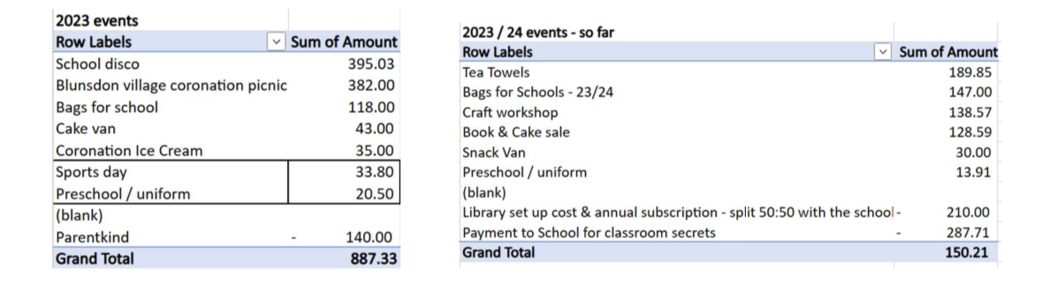
Events and fundraising Opportunities April ‘23 - April ‘24
Annual Statements:
The current balance is: £1037.54

Slide 4


The school projects that we have supported:
Library manager
Classroom secrets - English homework online
Other outgoings - Parentkind subscription

Slide 5
Roles
To be able to operate we must have 6 named persons on the
committee:
Chair
Vice Chair
Treasurer
Vice treasurer
Communications
Secretary
We are looking for new volunteers to join us. We attempt to allocate roles to suit personal strengths/preferences, however we all support each other. When it comes to events, we distribute the event roles and responsibilities evenly, ensuring that we always have minimum cover. The wonderful teachers all support with this too.

Slide 6
Responsibilities
Chair - Leads the committee, ensuring the PTA is run in line with its constitution and according the wishes of all members.
Vice Chair - Supports the Chair and takes on the role in their absence.
Treasurer - Controls the PTA funds in line with the committee’s decision as well as the charity law. They make sure upcoming events are affordable and profitable and report financial information to the rest of the team.
Vice treasurer - Supports the treasurer and takes on the role in their absence.
Communications - Is responsible for communicating events to parents, through leaflets, posters, newsletters and via the school website.
Secretary - Ensures that the PTA’s events run smoothly. They arrange meetings, prepare agenda’s, take minutes and keep records.
(And prepare amazing slide presentations!)

Slide 7
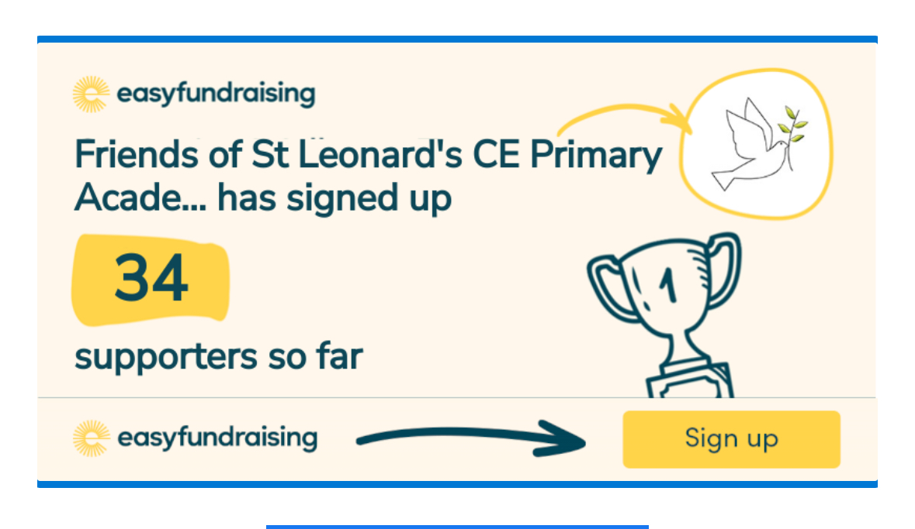
🤔
Did you know?
We now have our own page on the school website… keep a look out for details of all future events and photos from previous events.
You can raise money for your PTA by online shopping at your favourite stores… join the easyfundraising app, we will put the details on the website.

Slide 8
Questions, comments,
feedback and suggestions...

Slide 9
And finally…
Thank you for all of you continued support 👏🏻🙏🏻

